Slide 1
CCBD Assignment
Sanketh Reddy
Bhargav SNV
Abhishek Das

Slide 2
Bengaluru’s greenest part
Task 3

Slide 3
Dataset creation
We used google maps in label-less satellite mode.
Screenshots of each area were taken corresponding to pin codes manually.
The screenshots were then cropped to specific dimensions.
The resulting image(each pin code area) were then split into 9 parts based on their directional location with constant dimensions for more precision.

Slide 4
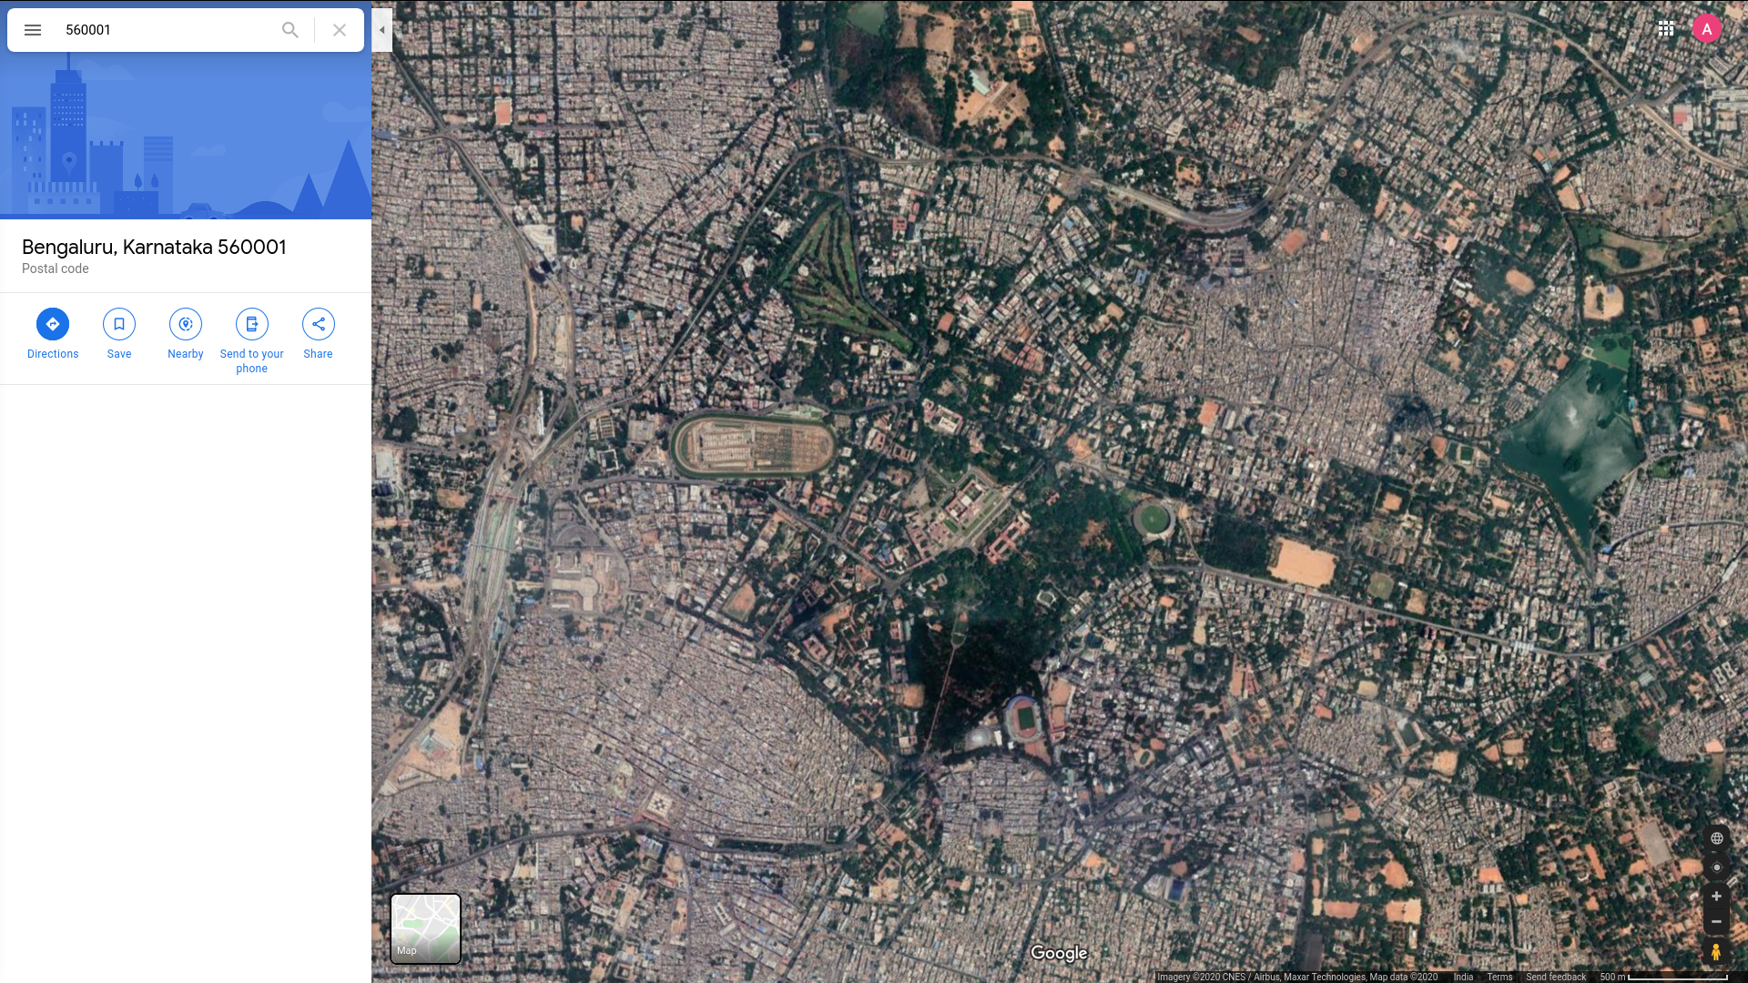
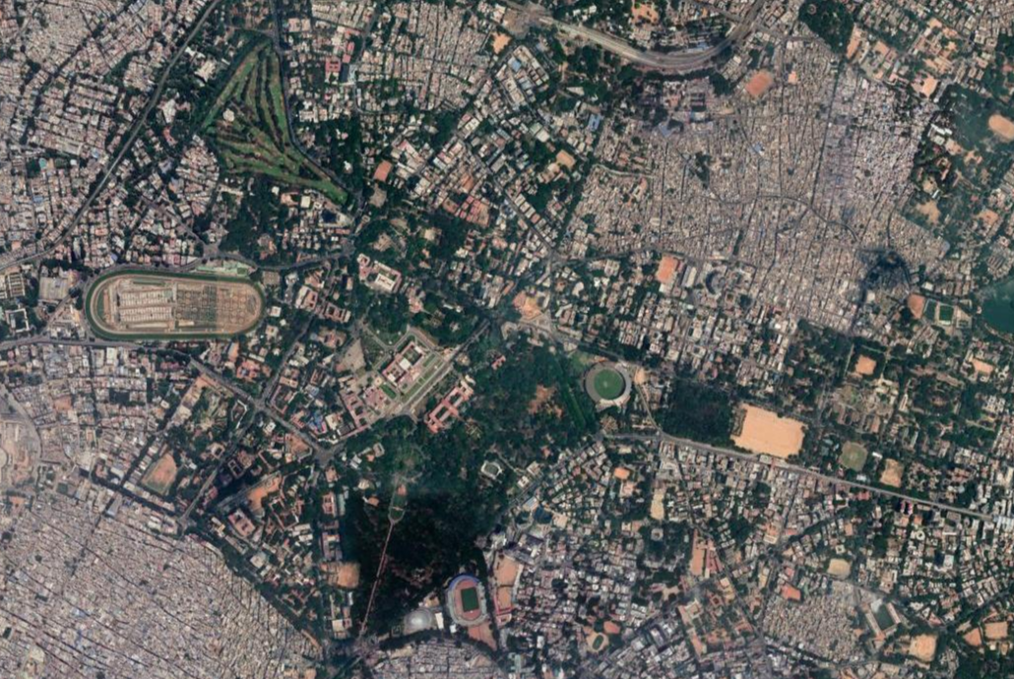
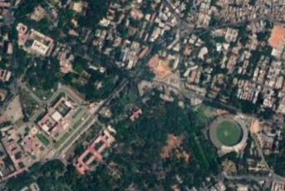
560001.png
(Cropped image)
560001.png
(screenshot)
560001-C.png
Central Sector
of the image

Slide 5
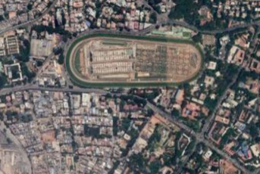
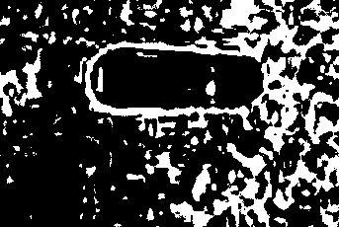
Image processing
A green mask of each image(sector) was acquired using a threshold HSV value for the color green.
The mask was then scanned to identify green pixels and then the percentage of green in the image was calculated using the number of green pixels in the mask.

Slide 6
Hadoop Cluster
A 3-node hadoop cluster was set up using 3 vagrant boxes.
MapReduce was run over the generated output from image processing.

Slide 7
Results

Slide 8
Who will share my load?
Task 1

Slide 9
Network layout

Slide 10
Server setups

Slide 11
Deployment

Slide 12
Thank you
Any questions?

